Slide 1


H
P
A

Slide 2
H
P
A

Slide 3
H
KGR
P
KGR
A

Slide 4
H
P
A

Slide 5
H
KGR
P
KGR
A

Slide 6
H
P
A

Slide 7
Adrenal ↓
Pituitary ↑
Period ~ 1 year
Pituitary ↓
Adrenal ↑

Slide 8



Slide 9
Adrenal ↓
Pituitary ↑
Period ~ 1 year
Pituitary ↓
Adrenal ↑

Slide 10
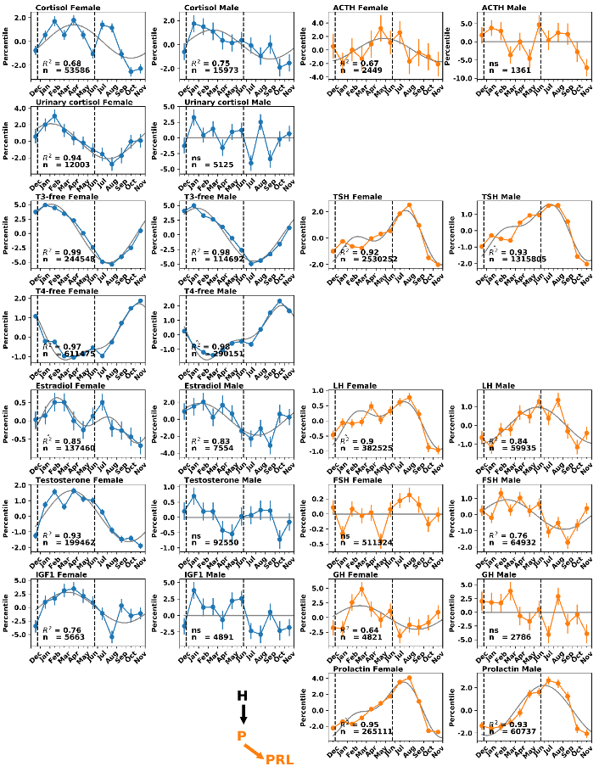
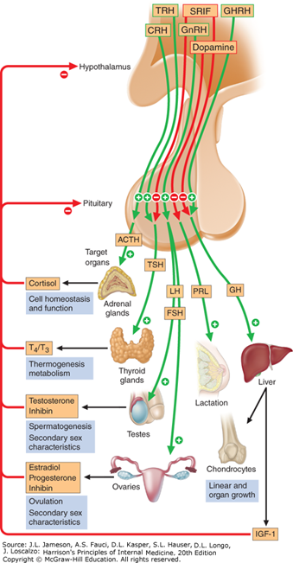
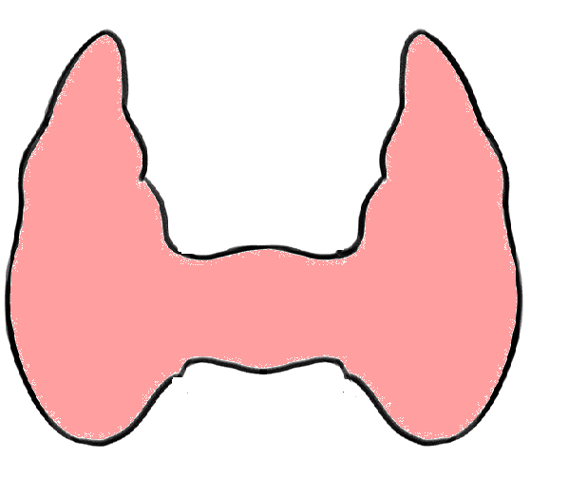

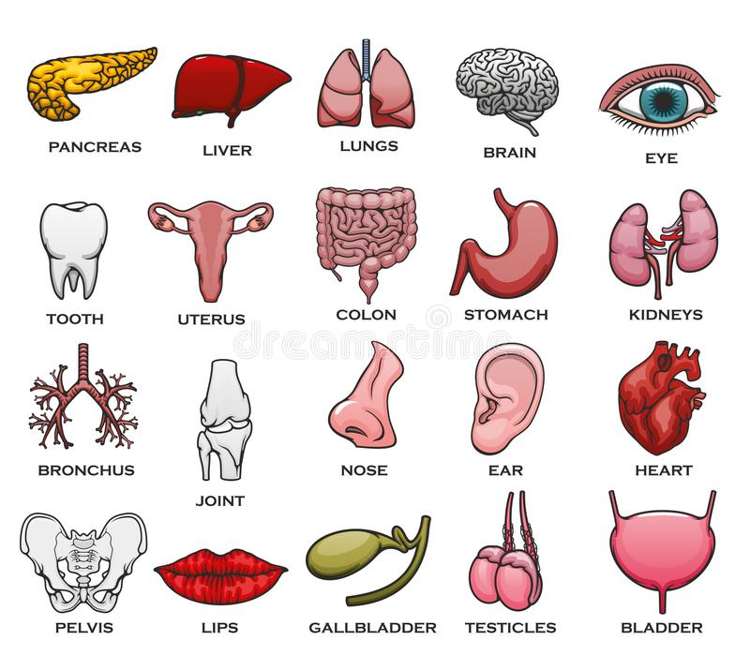
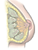

Slide 11
H
H
H
H
x1
x1
x1
x1
PG
PC
PT
PS
x2
A
x2
T
x2
L
x2
G
x3
x3
x3
x3
H
x1
PL
x2

